Slide 1

6.1
Areas in the Plane
Gateway Arch, St. Louis, Missouri
Photo by Vickie Kelly, 2003
Greg Kelly, Hanford High School, Richland, Washington

Slide 2



How can we find the area between these two curves?
We could split the area into several sections, use subtraction and figure it out, but there is an easier way.

Slide 3
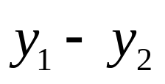
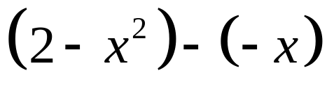
Consider a very thin vertical strip.
The length of the strip is:
or
Since the width of the strip is a very small change in x, we could call it dx.

Slide 4



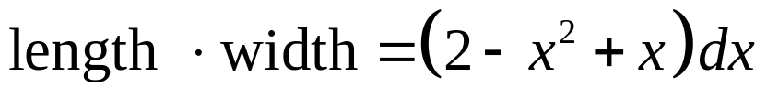
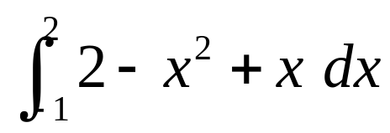
Since the strip is a long thin rectangle, the area of the strip is:
If we add all the strips, we get:

Slide 5
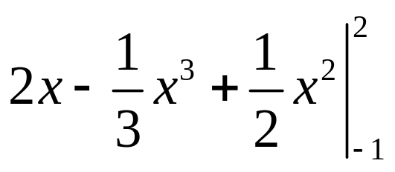
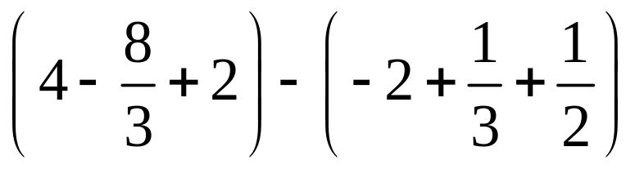
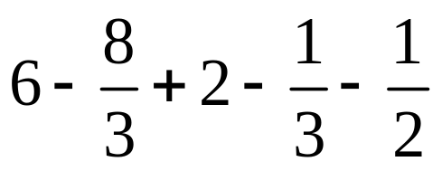
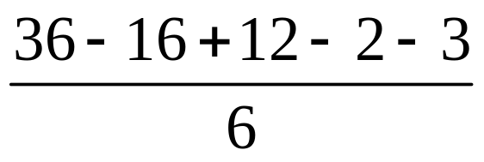
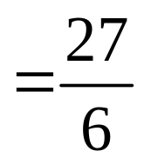
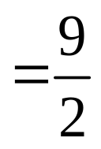

Slide 6
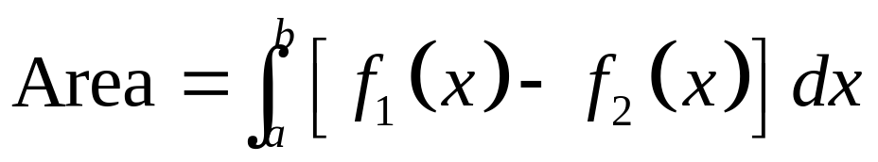
The formula for the area between curves is:
We will use this so much, that you won’t need to “memorize” the formula!

Slide 7
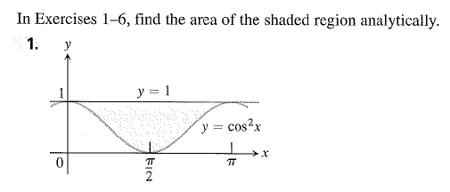
Now You Try!

Slide 8
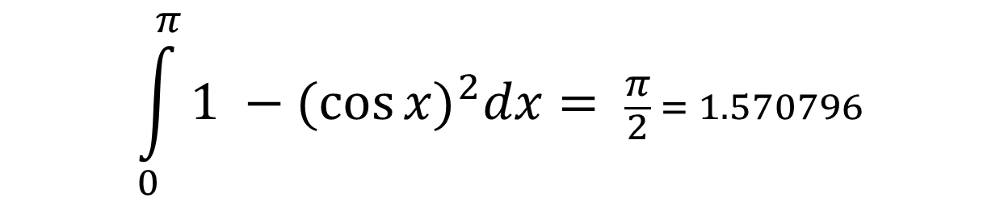
Solution

Slide 9


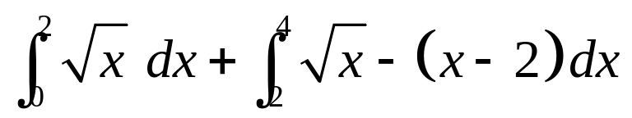

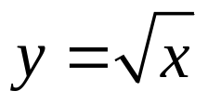

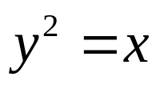

If we try vertical strips, we have to integrate in two parts:
We can find the same area using a horizontal strip.
Since the width of the strip is dy, we find the length of the strip by solving for x in terms of y.

Slide 10
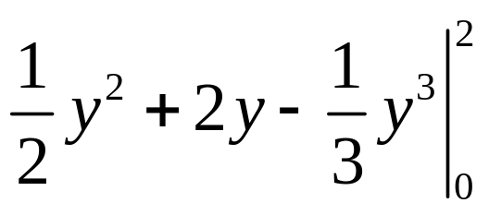
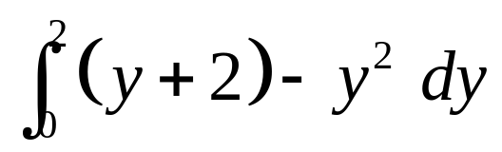
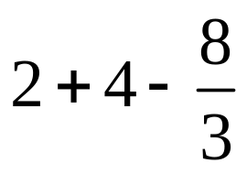
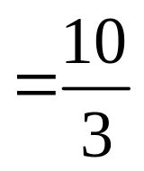
We can find the same area using a horizontal strip.
Since the width of the strip is dy, we find the length of the strip by solving for x in terms of y.
length of strip
width of strip

Slide 11

Now You Try! (#11)

Slide 12
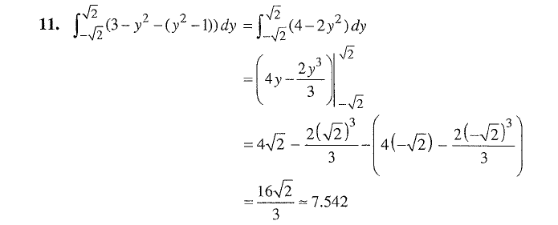
Solution

Slide 13
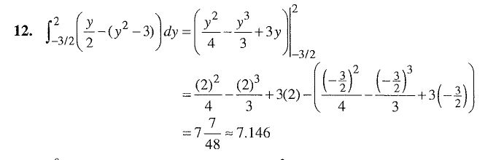
Solution

Slide 14
General Strategy for Area Between Curves:
1
Sketch the curves.
2
Decide on vertical or horizontal strips. (Pick whichever is easier to write formulas for the length of the strip, and/or whichever will let you integrate fewer times.)
3
Write an expression for the area of the strip.
(If the width is dx, the length must be in terms of x.
If the width is dy, the length must be in terms of y.
4
Find the limits of integration. (If using dx, the limits are x values; if using dy, the limits are y values.)
5
Integrate to find area.
π

Slide 15


Do #17 without a calculator
Do #22 and #23 with a calculator

Slide 16
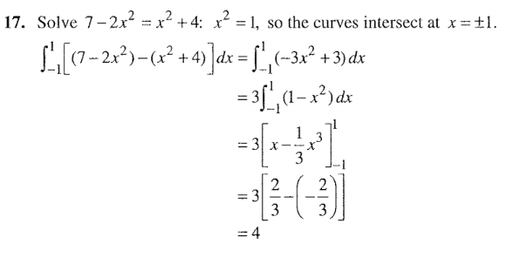

Slide 17
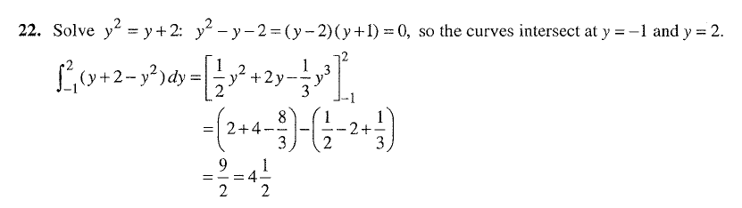

Slide 18
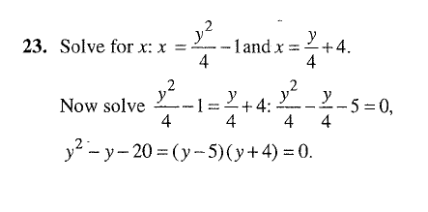
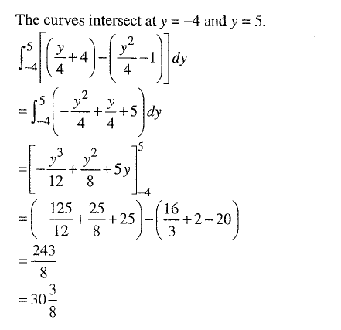

Slide 19
6.1 Area
Pg. 362 – 363: #13, #17, #31

